Slide 1

Transistors
Adam R. Kampff
Sainsbury Wellcome Centre, UCL
Banksy

Slide 2
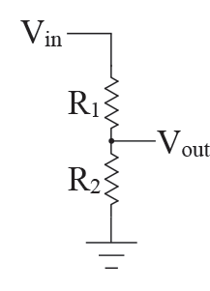
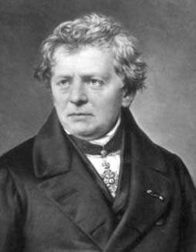
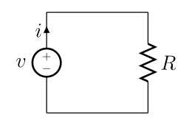
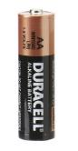
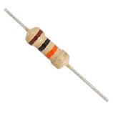
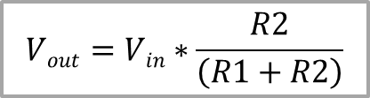
Linear Electronics
V = IR
Voltage Divider
V - Voltage: Force pushing electrons
(Volts)
I - Current: Number of electrons/second
(Amps)
R - Resistance: Ease to electron flow
(Ohms)
Ohm
$$Vout=Vin∗\frac{R2}{\left(R1+R2\right)}$$

Slide 3
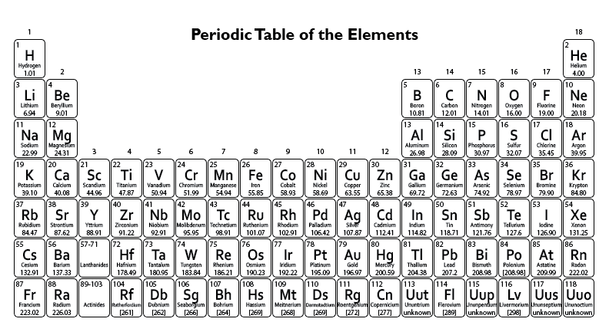
Semiconductor Devices
Whiteboard (P-type, N-type, PN Junction, Diode, Transistor)

Slide 4
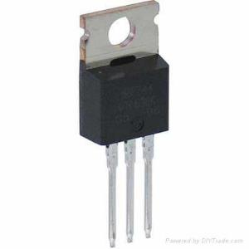
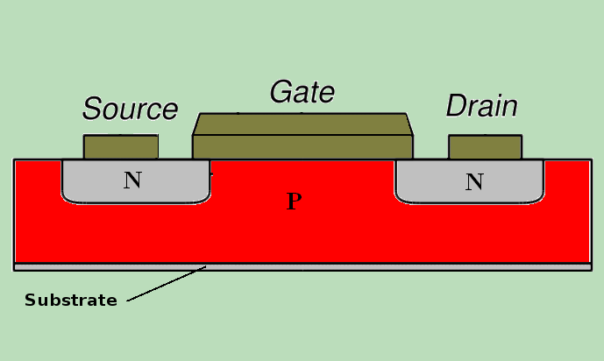
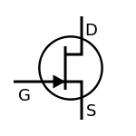
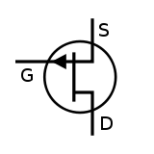
MOSFETs
Devices
CMOS = Complimentary Metal-Oxide-Semiconductor
- semiconductor device
- manufacturing process
MOSFET (metal-oxide-semiconductor field effect transistor)
G D S
“NPN” MOSFET (nMOS)
- Opens by creating a “N” channel through the “P” substrate, which requires a positive (+) gate voltage.
- The opposite is required for pMOS
N-MOSFET
P-MOSFET
pos (+) Gate
neg (-) Gate

Slide 5
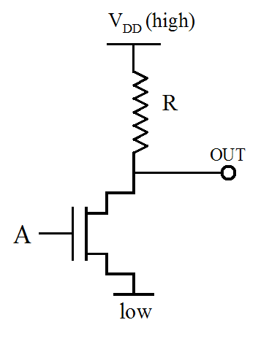
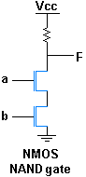
NMOS Logic
Devices
CMOS = Complimentary Metal-Oxide-Semiconductor
- semiconductor device
- manufacturing process
LOGIC
NMOS “NOT” Gate
(Inverter)

Slide 6
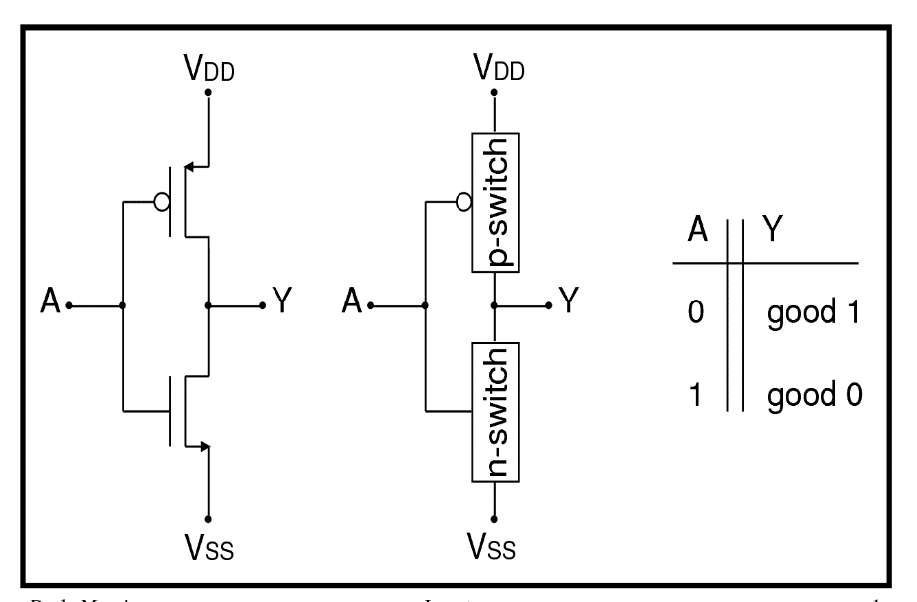
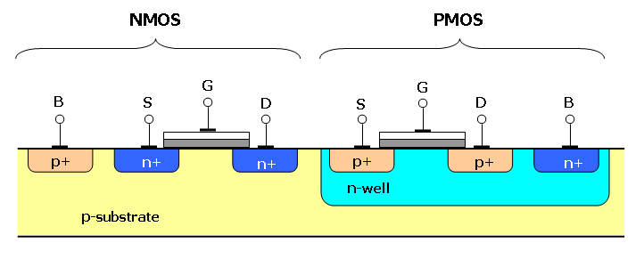
CMOS
Inverter
CMOS = Complimentary Metal-Oxide-Semiconductor
- semiconductor device
- manufacturing process
CMOS Inverter (NOT Gate)
CMOS enabled ultra Low Power Electronics
How do you make a CMOS device?

Slide 7
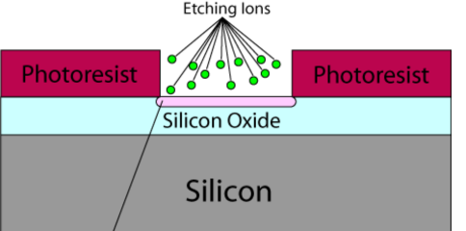
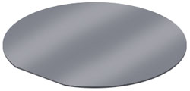

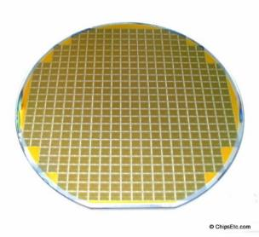
CMOS
Fabrication
CMOS = Complimentary Metal-Oxide-Semiconductor
- semiconductor device
- manufacturing process
How do you make a CMOS device?
Deposition/Etching
Photolithography
Mask
Silicon Wafer
“On Wafer” Devices
Post-Processing

Slide 8
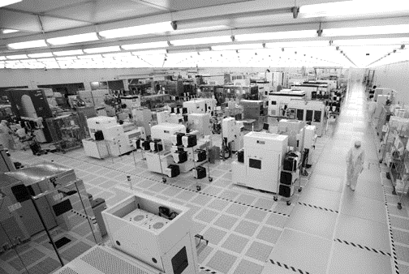
CMOS
Fabrication
CMOS = Complimentary Metal-Oxide-Semiconductor
- semiconductor device
- manufacturing process
How do you make a CMOS device?
CMOS Fab (cleanroom)

Slide 9
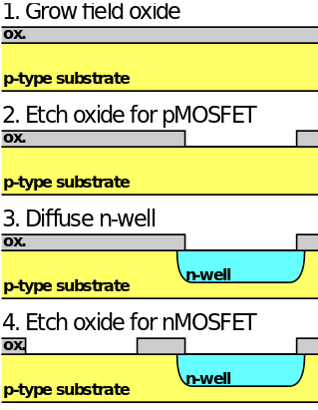
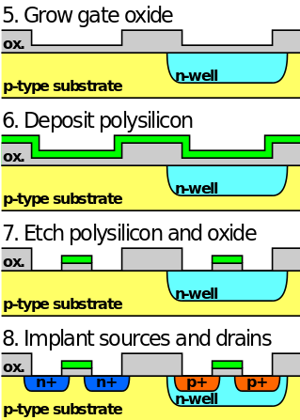
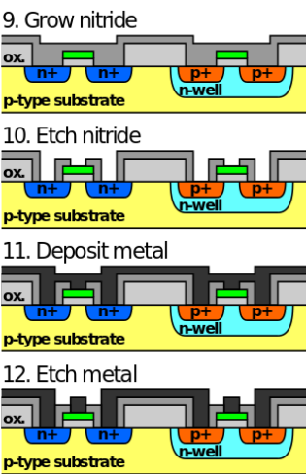
CMOS
Fabrication
CMOS = Complimentary Metal-Oxide-Semiconductor
- semiconductor device
- manufacturing process

Slide 10
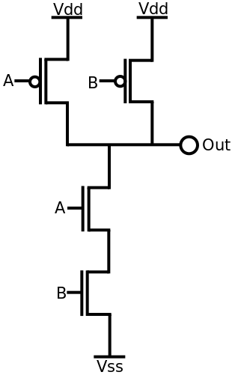
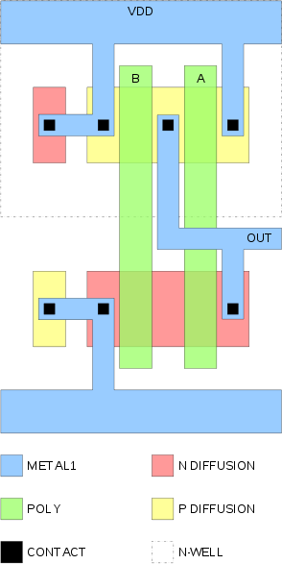
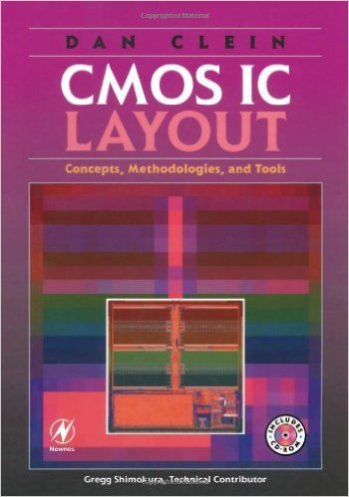
CMOS
Layout
CMOS = Complimentary Metal-Oxide-Semiconductor
- semiconductor device
- manufacturing process
CMOS NAND Gate

Slide 11
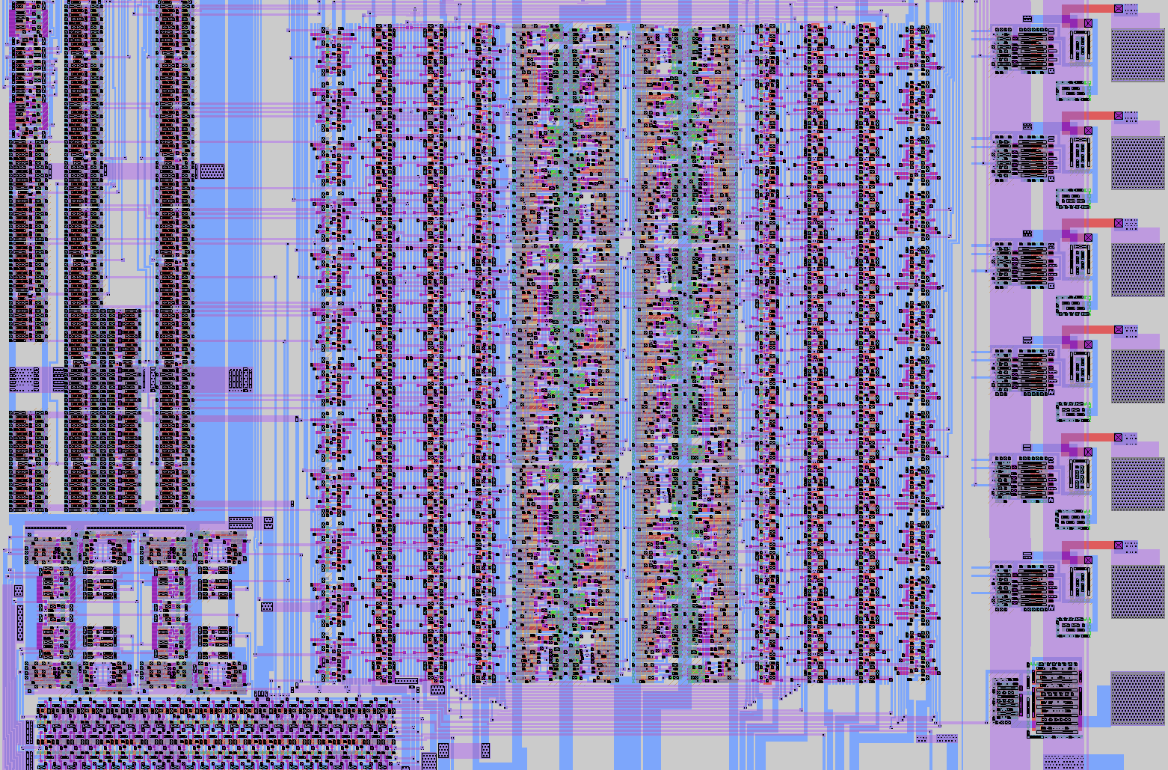
CMOS
Gone wild!

Slide 12
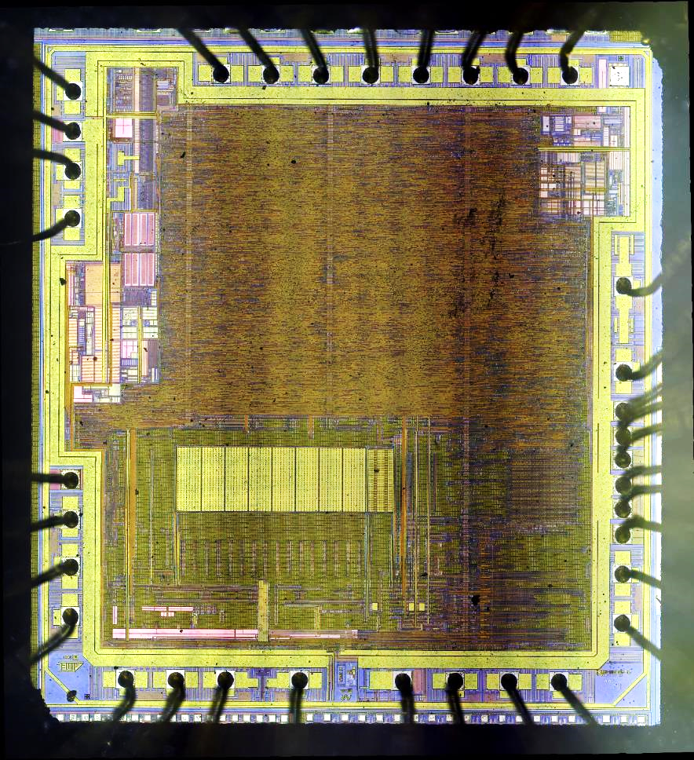
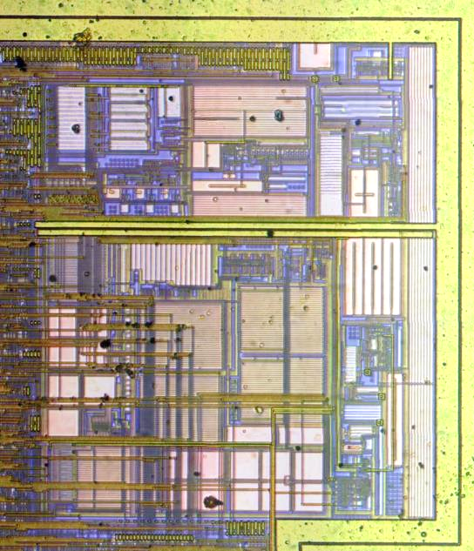
CMOS
Gone wild!
Atmel Mega 328P
ALU (arithmetic/logic unit)

